Slide 1


2017 Community Survey Town of Snowmass Village, CO
Presented by
September 2017

Slide 2
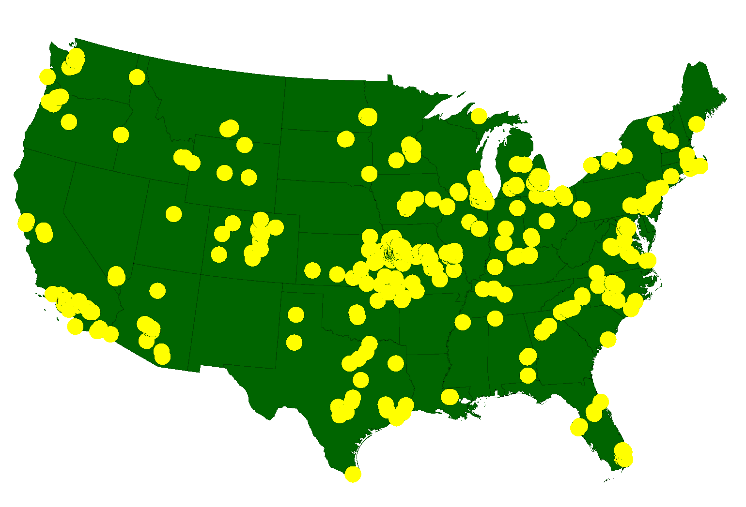
ETC Institute
A National Leader in Market Research for Local Governmental Organizations …helping Town and county governments gather and use survey data to enhance organizational performance for more than 30 years
More than 2,150,000 Persons Surveyed Since 2006
for more than 900 cities in 49 States

Slide 3
Agenda
Purpose and Methodology
Bottom Line Upfront
Major Findings
2
Summary
Questions

Slide 4
Purpose
To objectively assess citizen satisfaction with the delivery of Town services
To compare the Town’s performance with residents in other communities regionally and nationally
To measure trends from previous surveys
To help determine priorities for the community

Slide 5
Methodology
Survey Description
survey took approximately 15-20 minutes to complete
included some of the same questions from previous surveys
Method of Administration
online to year-round Snowmass Village residents, part-time Snowmass Village residents, guests, and Roaring Fork Valley residents (outside of Snowmass)
cross-tabs show the results for each of the 4 groups
Sample size:
goal number of surveys: 600
goal far exceeded: 891 completed surveys
Confidence level: 95%
Margin of error: +/- 3.3% overall

Slide 6
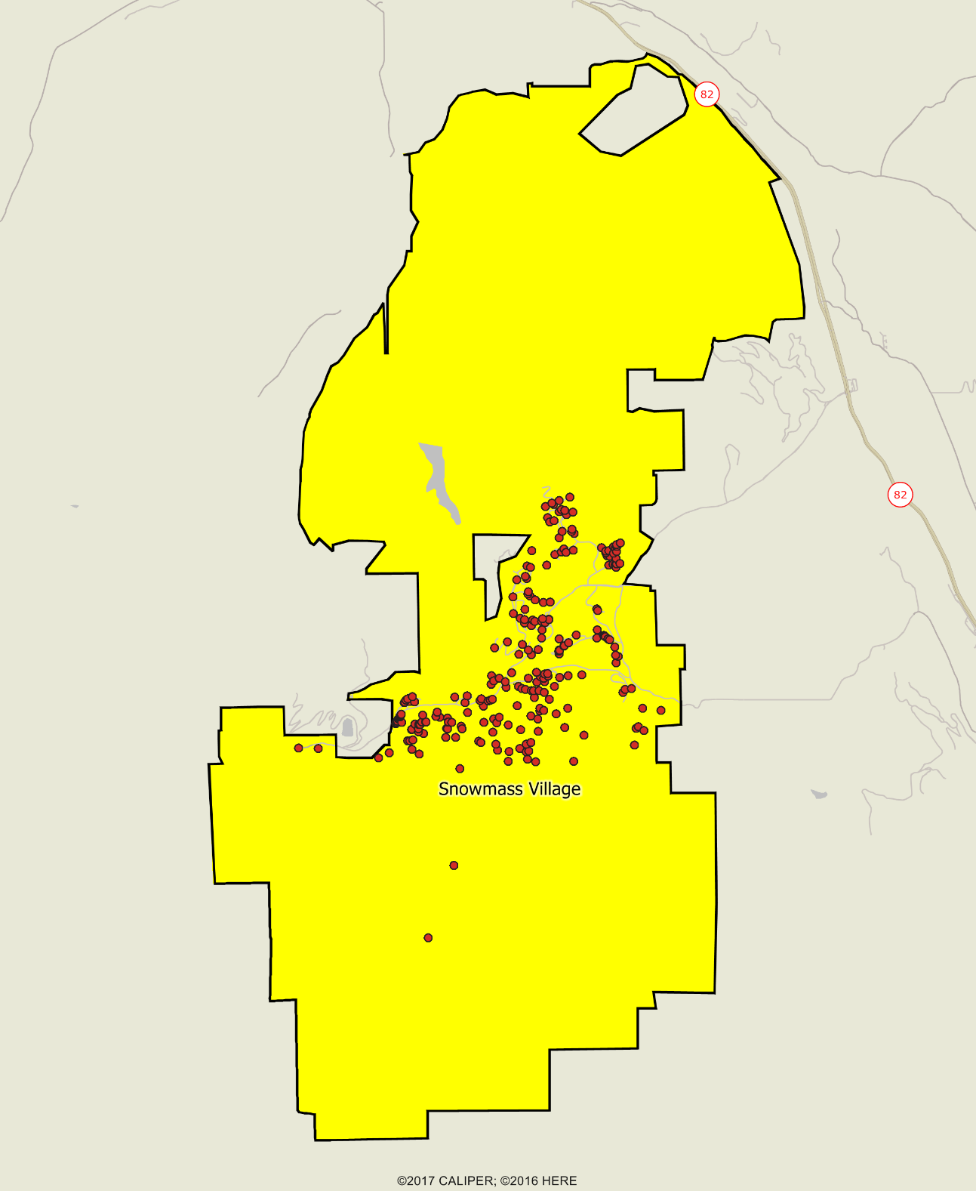

Location of Survey
Respondents
Town of Snowmass 2017 Community Survey

Slide 7
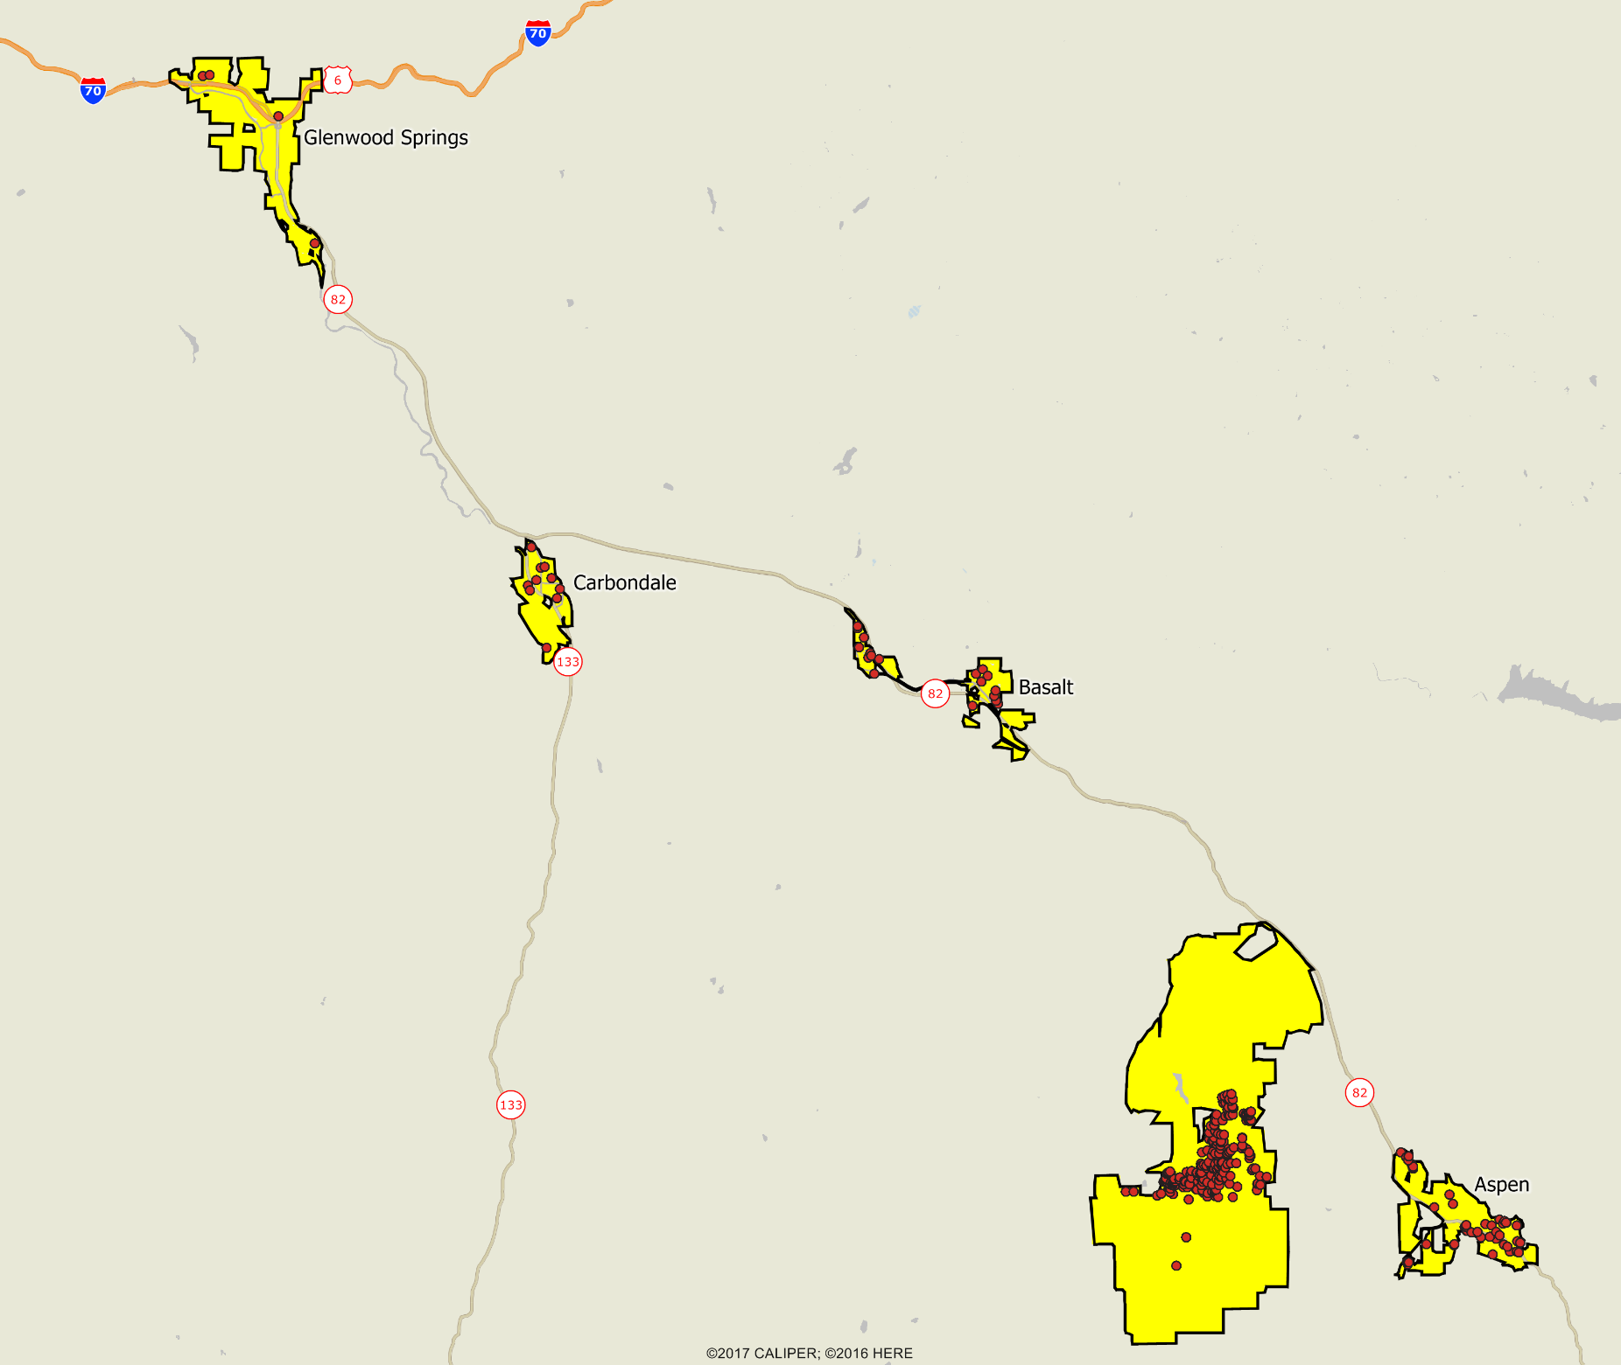
Location of Survey
Respondents
Town of Snowmass 2017 Community Survey

Slide 8
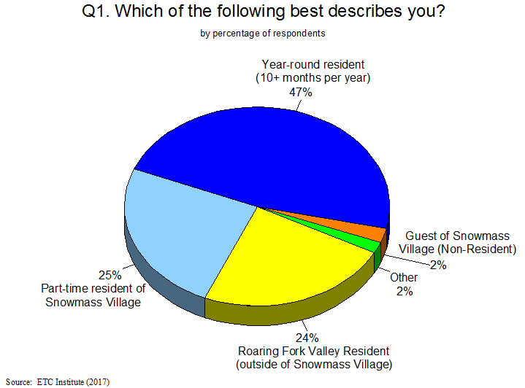
8

Slide 9
Bottom Line Up Front
Residents Have a Very Positive Perception of the Town
96% of residents feel safe in Snowmass Village
89% of residents are “very satisfied” or “satisfied” with the overall quality of life in the Town
The Town Is Moving in the Right Direction
Satisfaction ratings have increased in most areas since 2015, especially regarding police services, communication efforts, and feeling of a sense of community in Snowmass
Satisfaction with Town Services Is Much Higher in Snowmass Village Than Other Communities
Snowmass rated significantly higher than other communities in all 17 areas that were compared
Snowmass rated 27% above the U.S. Average in the Overall Quality of Town Services
Most Important Town Council Strategic Goals:
Working regionally with local partners to solve significant issues
Maintaining & increasing public safety by increasing connectivity

Slide 10
Major Finding #1
Residents Have a Very Positive Perception of the Town

Slide 11
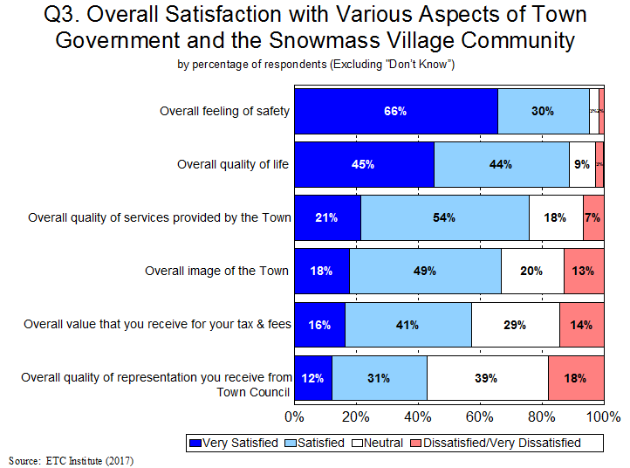
Nearly an 11-1 Ratio of Residents Who Are Satisfied vs. Dissatisfied with the Overall Quality of Services Provided by the Town (75% vs. 7%)
11

Slide 12
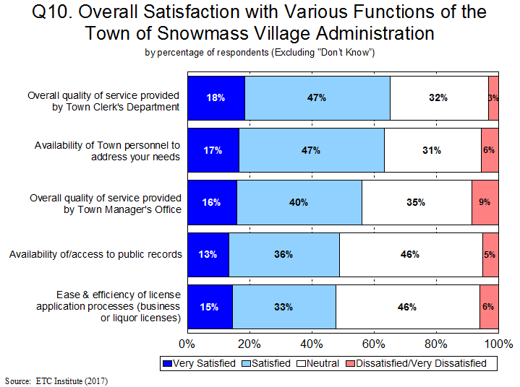
12
Less Than 10% of Residents Are Dissatisfied with Any Functions That Were Rated

Slide 13
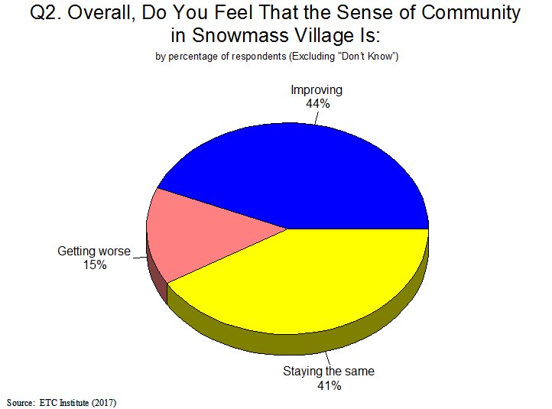
44% of Residents Feel the Sense of Community in Snowmass Village Is Improving, Compared to Only 15% Feel It’s Getting Worse
13

Slide 14
Major Finding #2
The Town Is Moving in the Right Direction

Slide 15
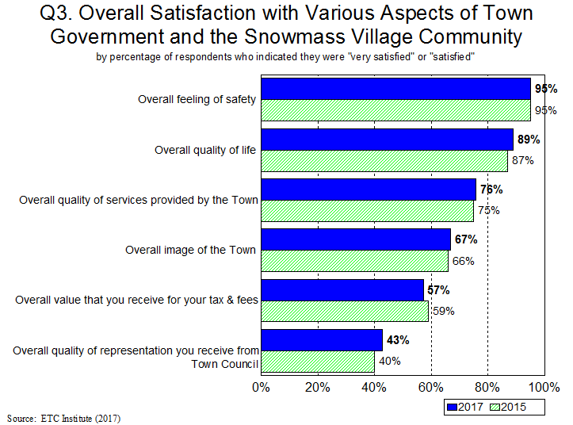
15
Satisfaction Ratings Have Increased or Stayed the Same in 5 of 6 Areas

Slide 16
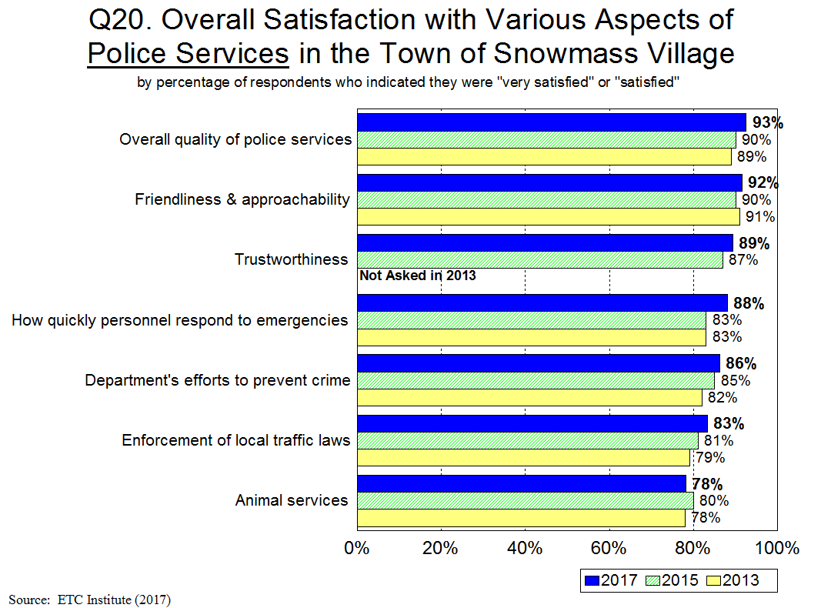
16
Satisfaction Ratings Have Increased in 6 of 7 Areas Since 2015

Slide 17
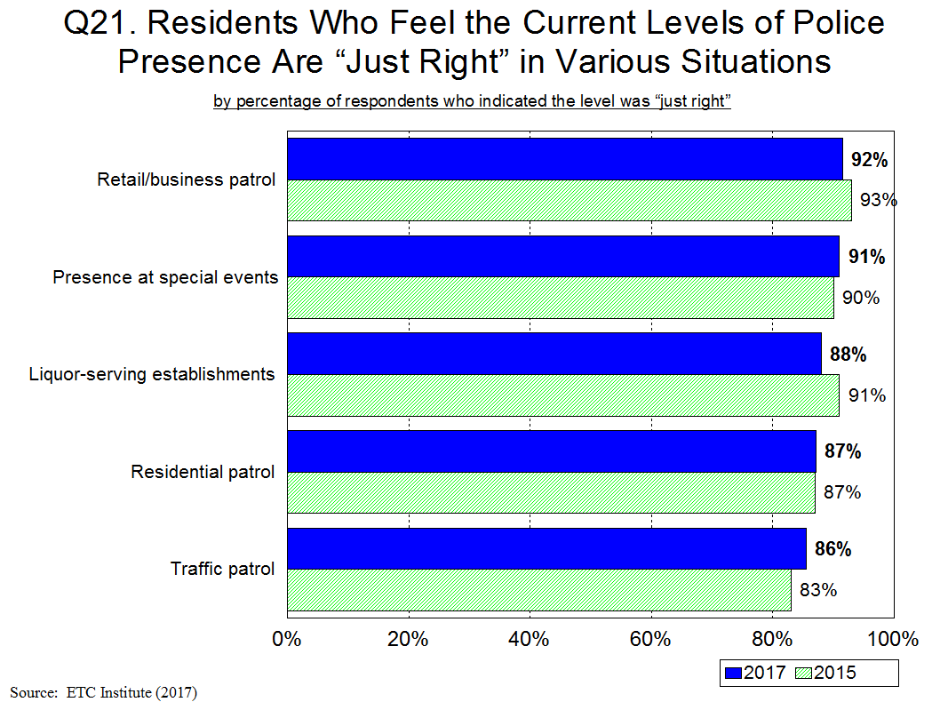
17
Nearly All Residents Feel the Level of Police Presence Is Just Right in All Situations

Slide 18
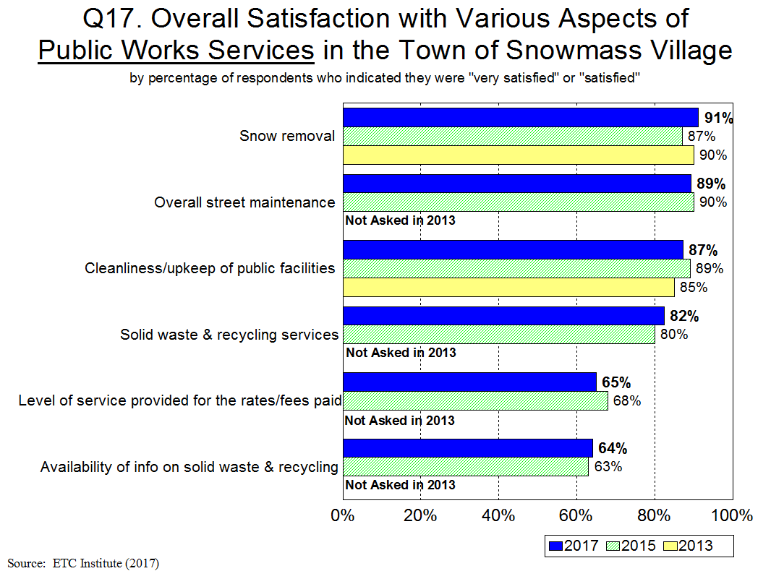
18
Satisfaction Ratings Have Increased in 3 of 6 Areas Since 2015

Slide 19
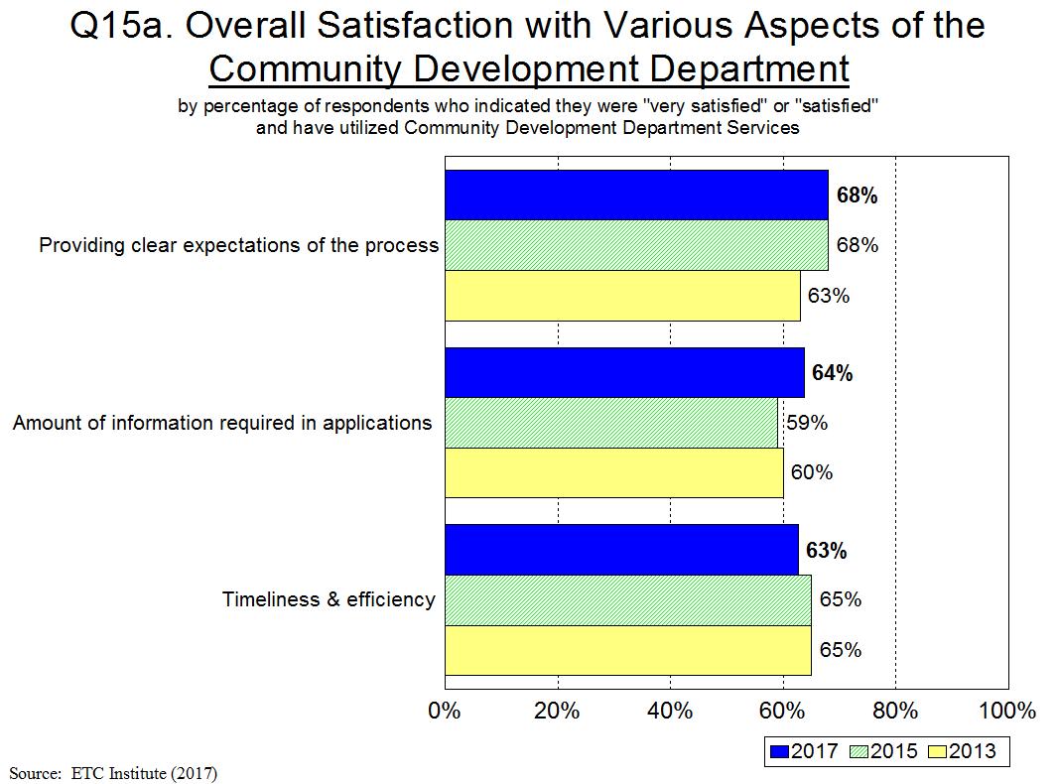
19
Satisfaction Ratings Have Increased or Stayed the Same in 2 of 3 Areas Since 2015

Slide 20
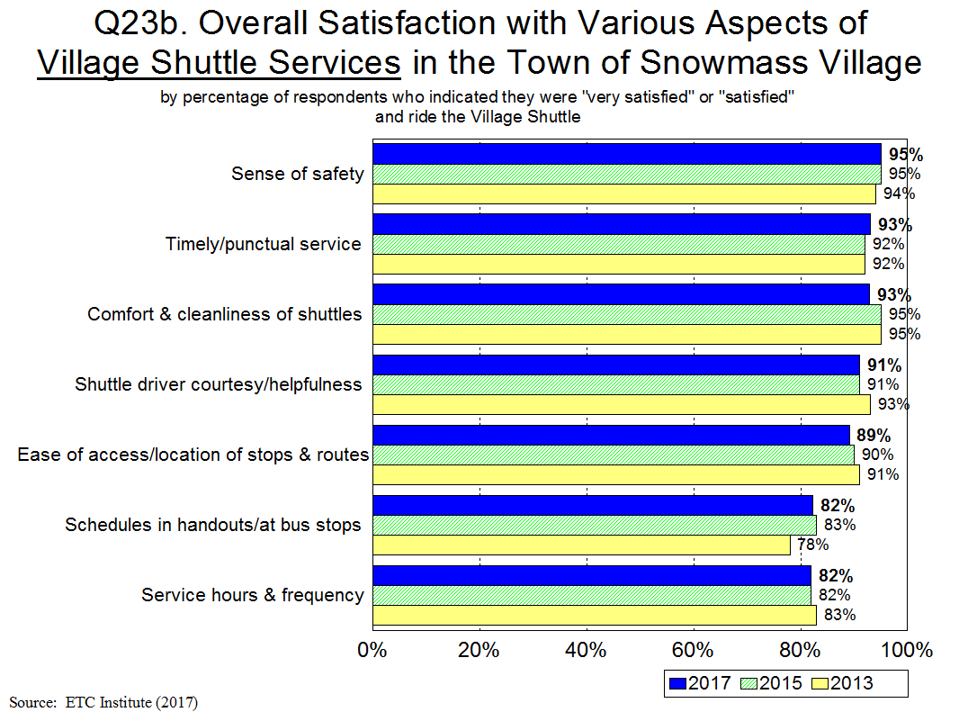
20
Satisfaction Ratings Have Increased or Stayed the Same in 4 of 7 Areas Since 2015

Slide 21
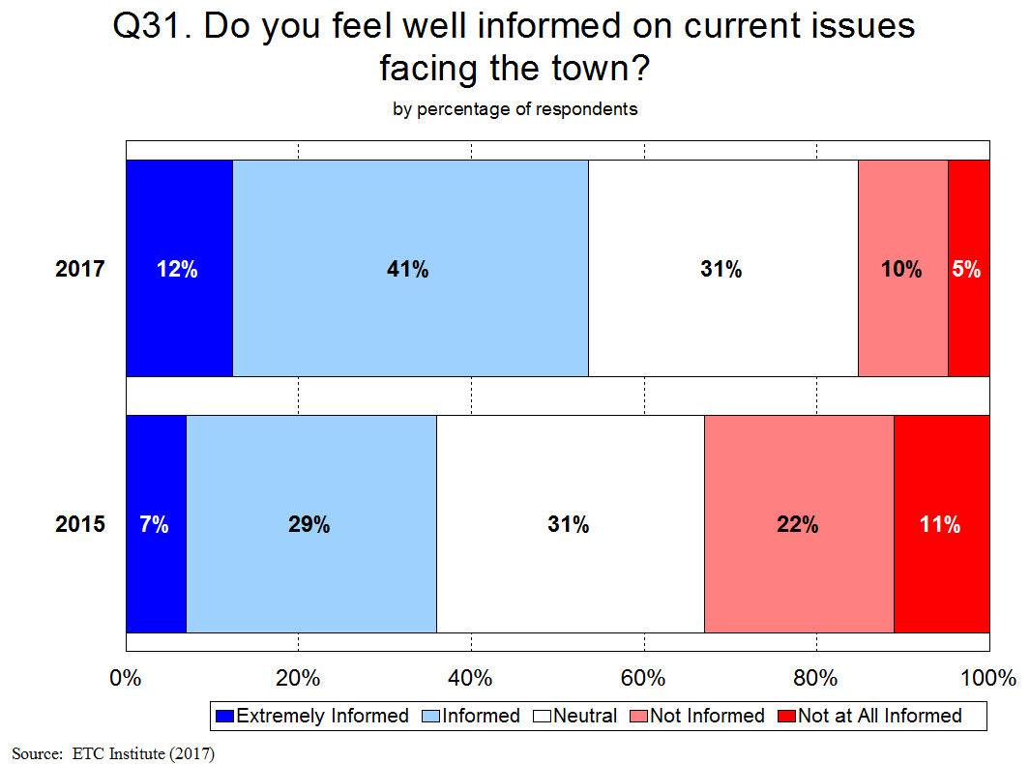
In 2017, 53% of Residents Feel They’re Extremely Informed or Informed on Current Town Issues, Compared to Only 36% in 2015
21

Slide 22
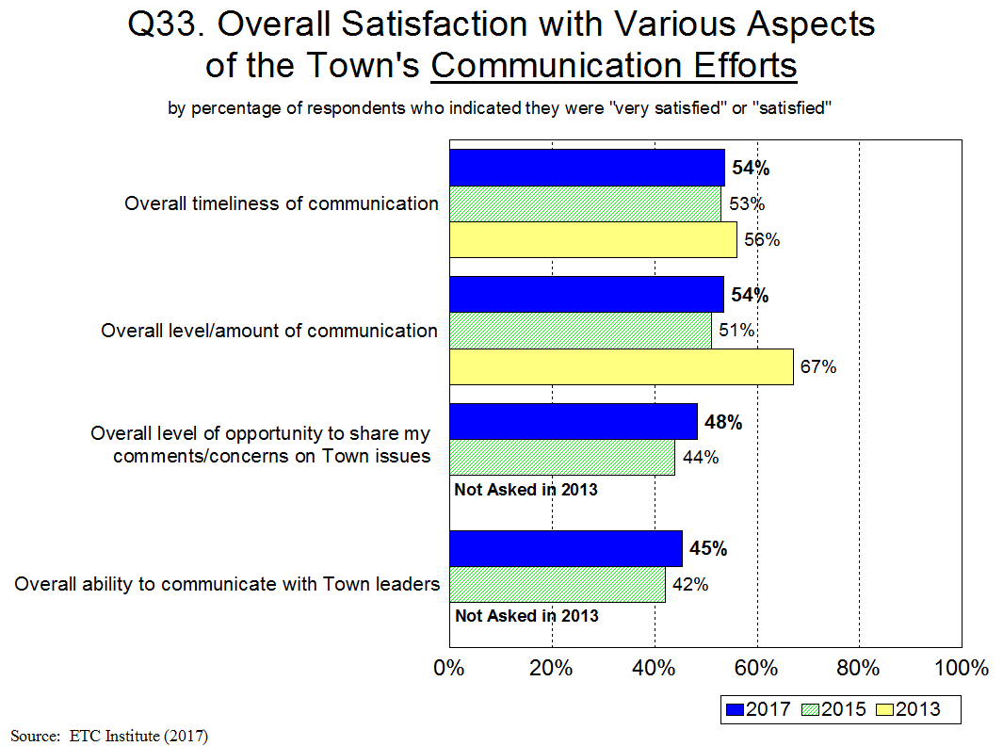
22
Satisfaction Ratings Have Increased in All 4 Areas Since 2015

Slide 23
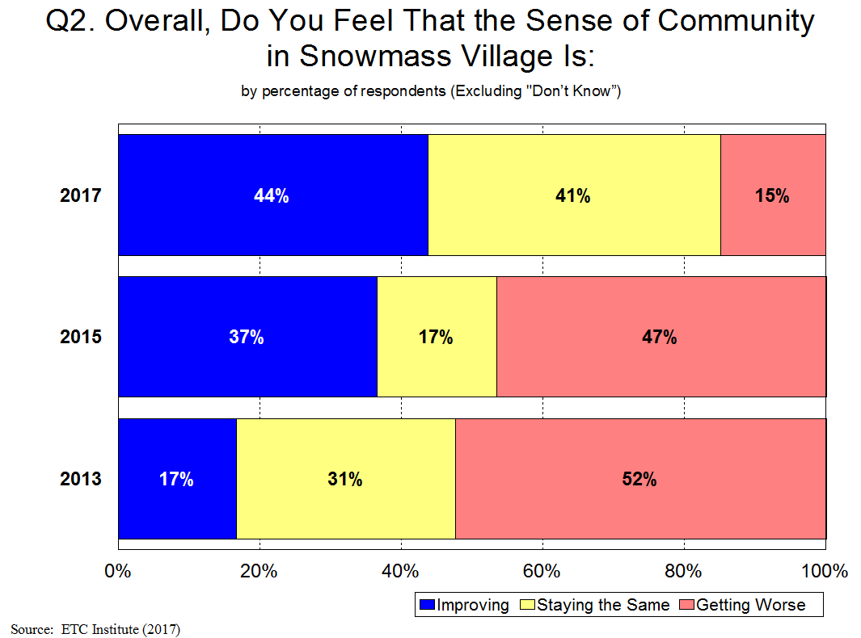
In 2017 85% of Residents Feel the Sense of Community in Snowmass Village Is Improving or Staying the Same, Compared to Only 54% in 2015, and 48% in 2013

Slide 24
Major Finding #3
Satisfaction Levels in Snowmass Village Are Significantly Higher than Other Communities

Slide 25
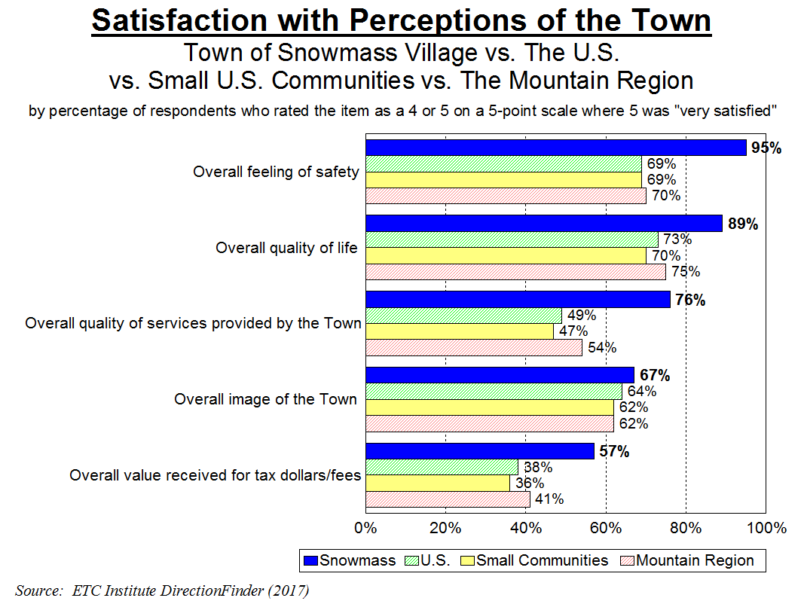
Snowmass Rates 27% Above the U.S. Average in the Overall Quality of Town Services, and
19% Above the U.S. Average in the Overall Value Received for Tax Dollars and Fees
25

Slide 26
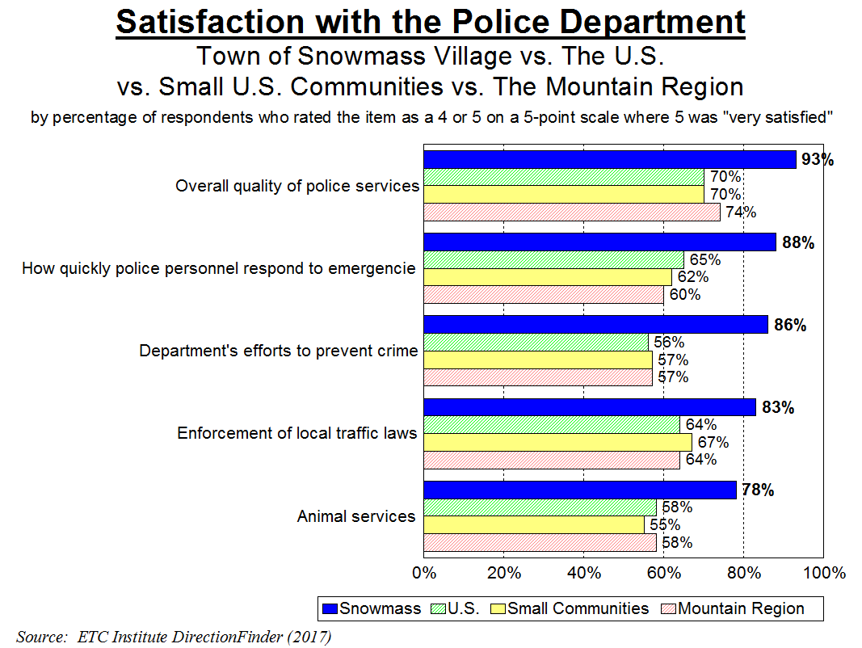
26
Snowmass Rates Significantly Higher Than Other Communities in All 5 Areas

Slide 27
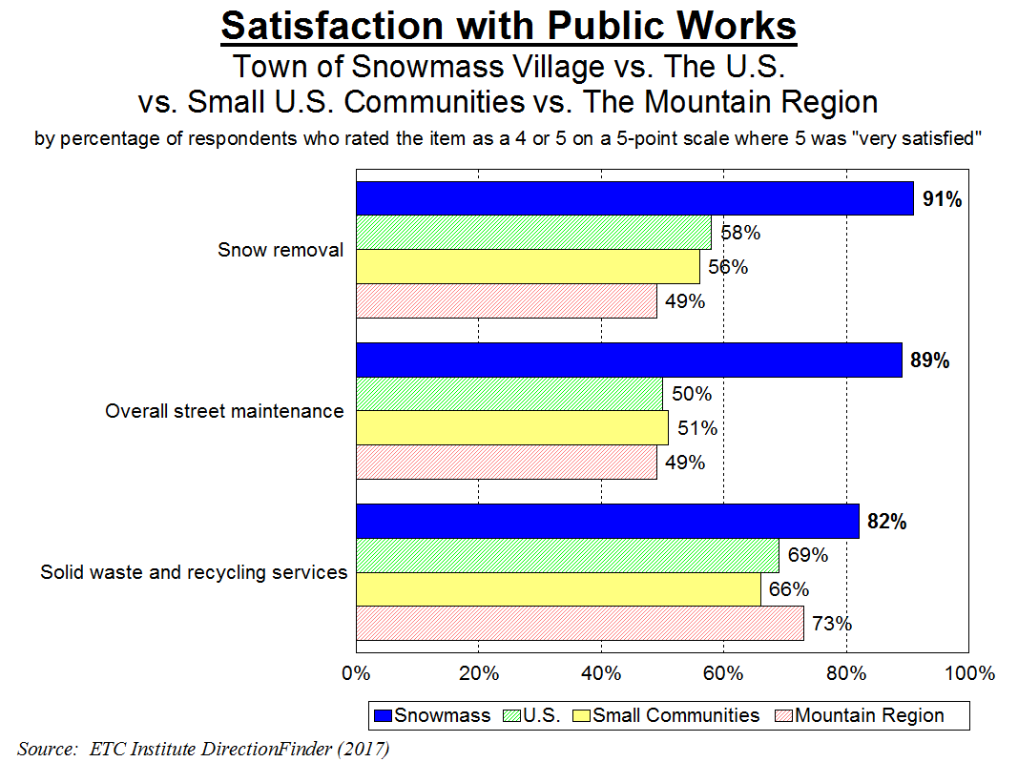
27
Snowmass Rates Significantly Higher Than Other Communities in All 3 Areas

Slide 28
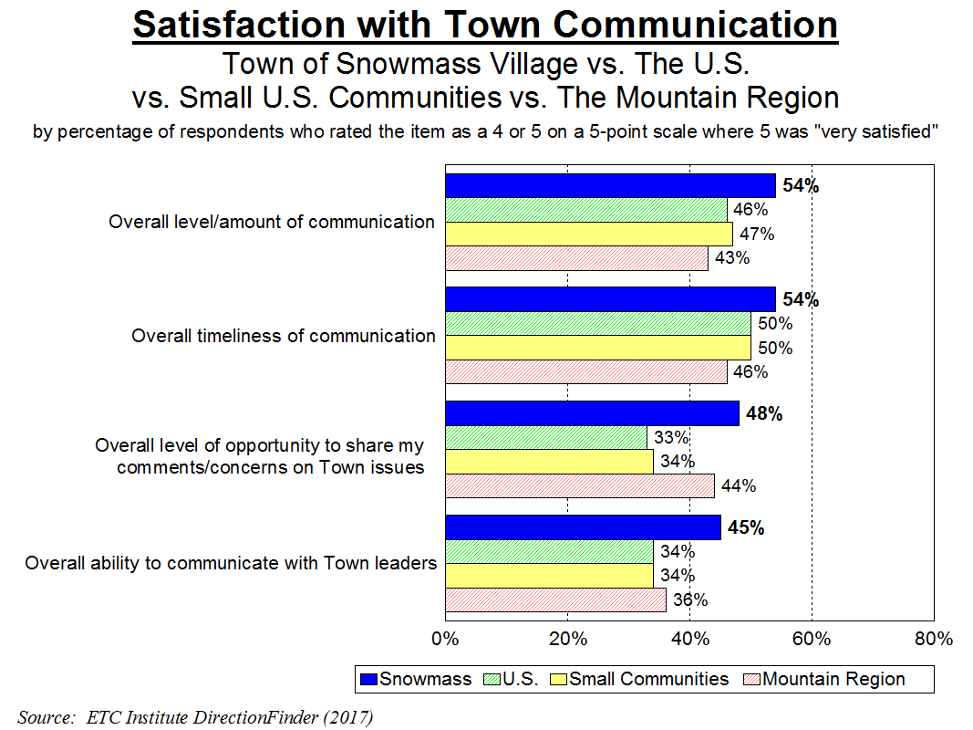
28
Snowmass Rates Significantly Higher Than Other Communities in All 4 Areas

Slide 29
Major Finding #4
Top Priorities

Slide 30
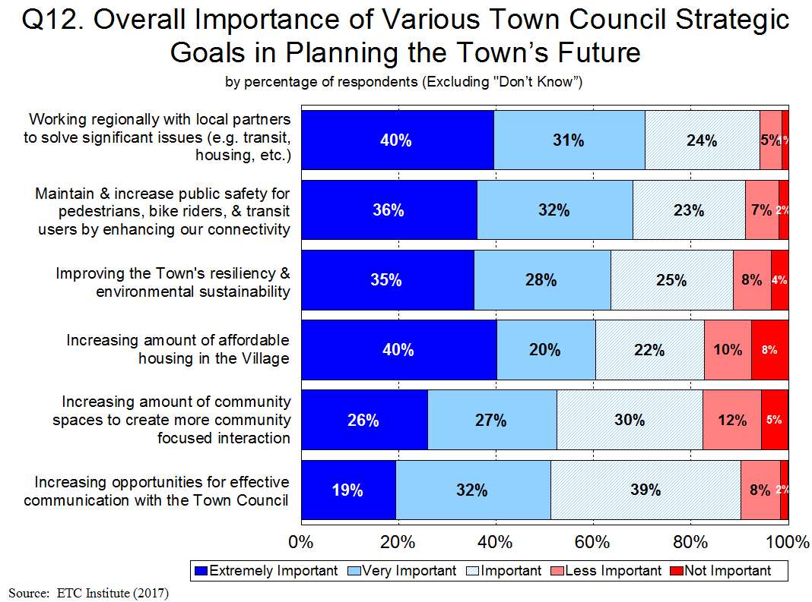
Most Important Strategic Goals Are: 1) Working Regionally with Local Partners to Solve Significant Issues and 2) Maintaining & Increasing Public Safety by Increasing Connectivity
30

Slide 31
Other Findings

Slide 32
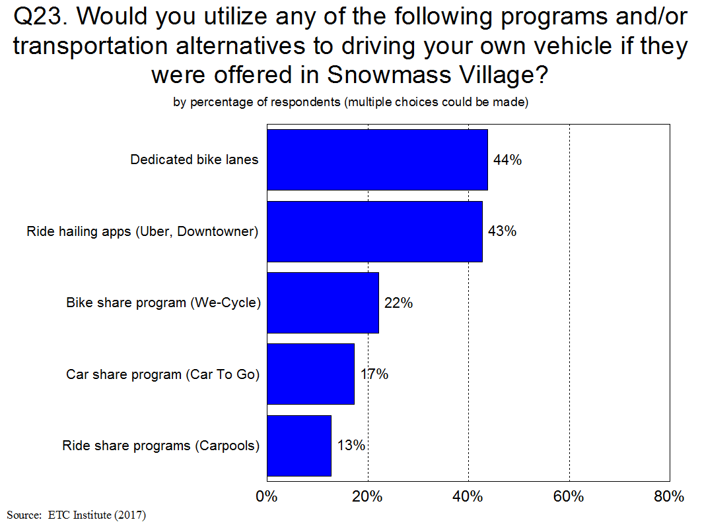
32

Slide 33
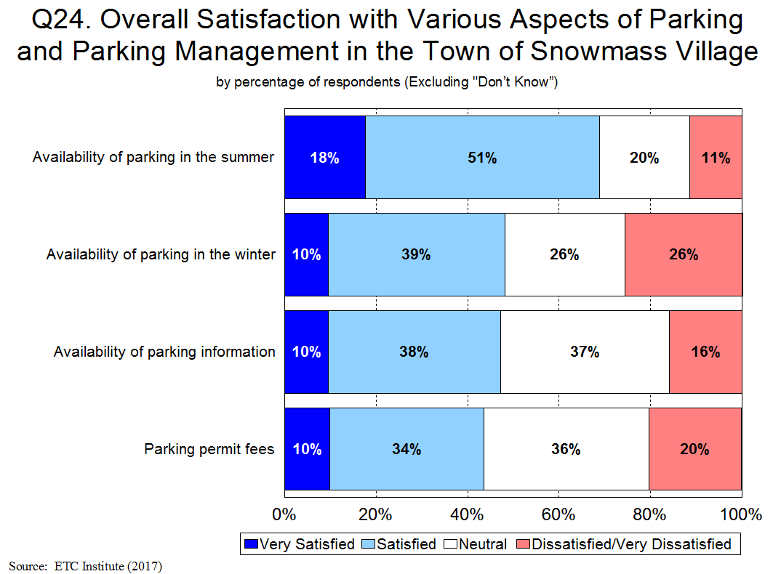
33

Slide 34
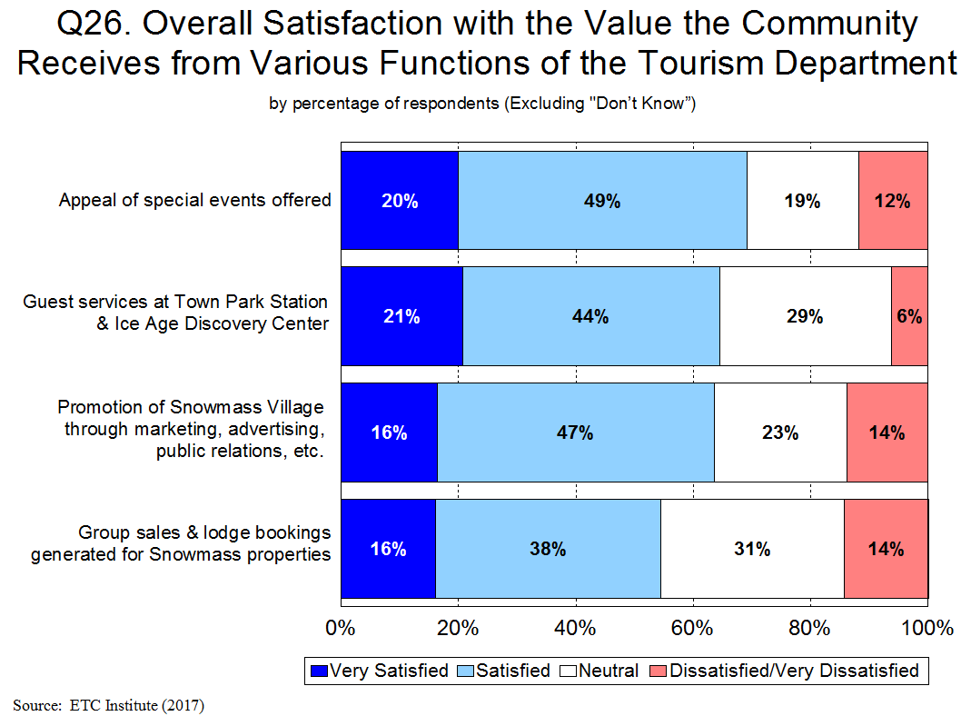
34

Slide 35
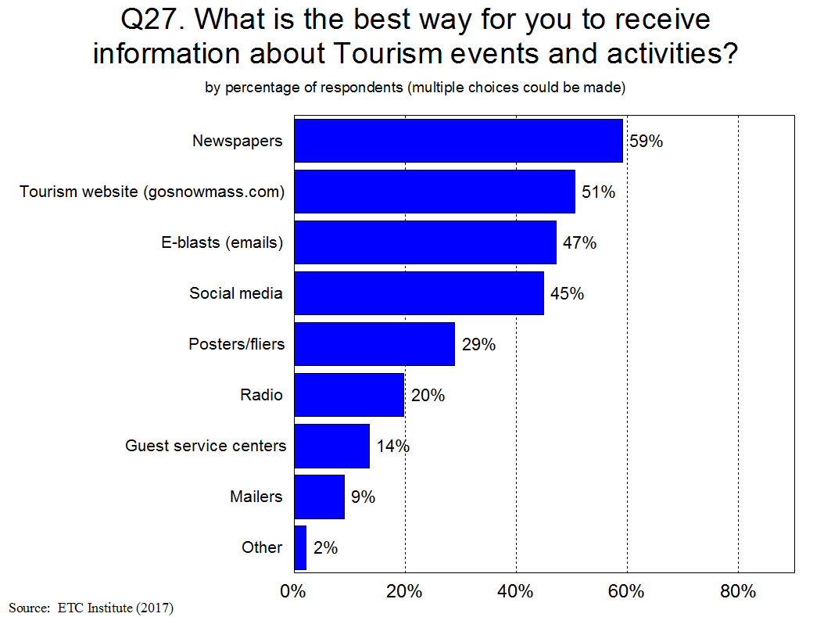
35

Slide 36
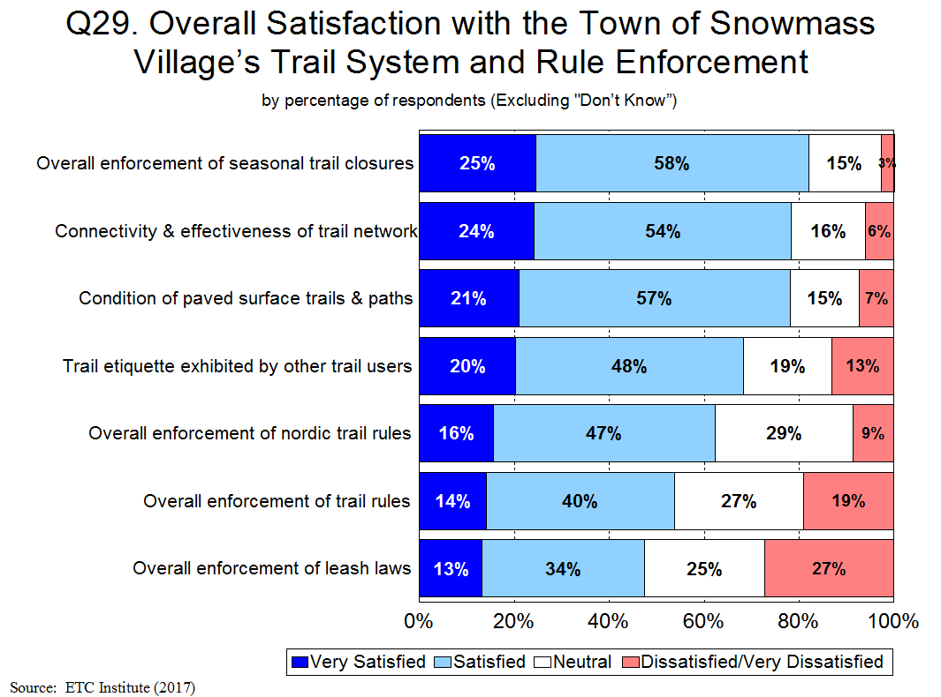
36

Slide 37
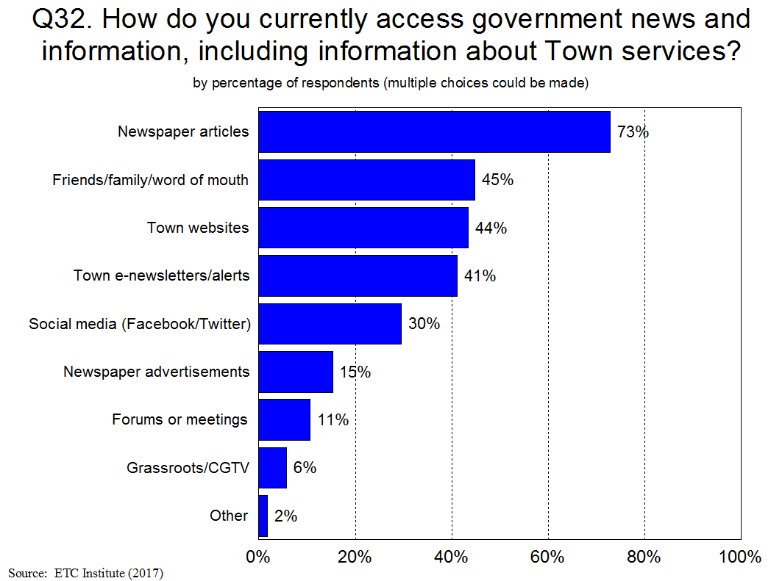
37

Slide 38
Summary
Residents Have a Very Positive Perception of the Town
96% of residents feel safe in Snowmass Village
89% of residents are “very satisfied” or “satisfied” with the overall quality of life in the Town
The Town Is Moving in the Right Direction
Satisfaction ratings have increased in most areas since 2015, especially regarding police services, communication efforts, and feeling of a sense of community in Snowmass
Satisfaction with Town Services Is Much Higher in Snowmass Village Than Other Communities
Snowmass rated significantly higher than other communities in all 17 areas that were compared
Snowmass rated 27% above the U.S. Average in the Overall Quality of Town Services
Most Important Town Council Strategic Goals:
Working regionally with local partners to solve significant issues
Maintaining & increasing public safety by increasing connectivity

Slide 39
Questions?
THANK YOU!!

